Slide 1
Stock Market Prediction Using LSTM & Transformer architecture
A Deep Learning 046211 Project by Assaf and Tal

Slide 2
Introduction
Goal
Challenge
Analysis
Demonstrate that financial news reports, combined with historical market data, can improve stock market performance prediction.
Stock market prediction is inherently complex and uncertain.
Comparison between different model architectures and the naive predictor.

Slide 3
Methodology - Data Sources
 | LSTM | LSTM & BERT transformer
Data | S&P 500 closing prices | NIFTY500 Closing prices + financial news articles
Date range | 2005-2020 | 2012-2018

Slide 4
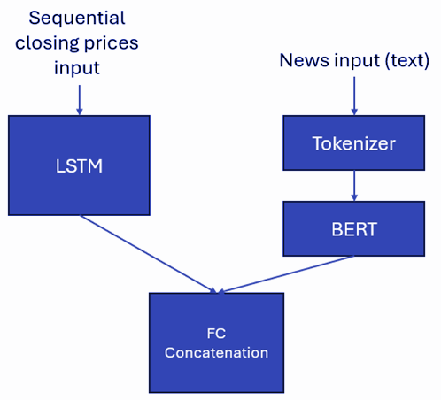
Methodology - Model Architecture
Our model utilizes an LSTM module (for sequential closing price data), as well as a BERT transformer module (for financial news data) to predict daily gain/loss
The reference model is LSTM only
Hyper-parameters tuned with Optuna
MSE was chosen as the Loss criterion for both models

Slide 5
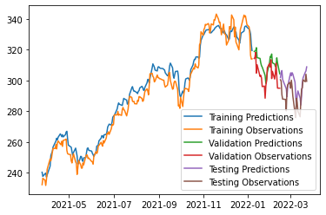
Methodology - Predicted Value
In contrast to previous similar projects, we chose to predict the daily gain/loss instead of the closing price. At first, closing price as the prediction looks like it returns great results, but upon further analysis it is clear that it has a ‘one day delay’ from the real value.

Slide 6
Methodology - Optuna
LSTM
LSTM & BERT
LSTM Hidden size | 2
Stacked Layers | 1
Lookback | 30
Optimizer | Adam
Batch Size | 32
Learning rate | 0.0001304
Step size | 1
Scheduler 𝜸 | 0.714389
LSTM Hidden size | 64
Stacked Layers | 4
Sequence length | 6
Optimizer | RMSprop
Batch Size | 16
Learning rate | 0.0008194
Step size | 10
Scheduler 𝜸 | 0.68994

Slide 7
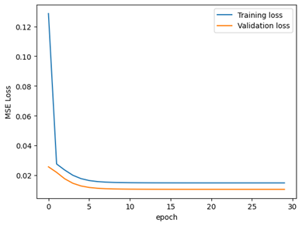
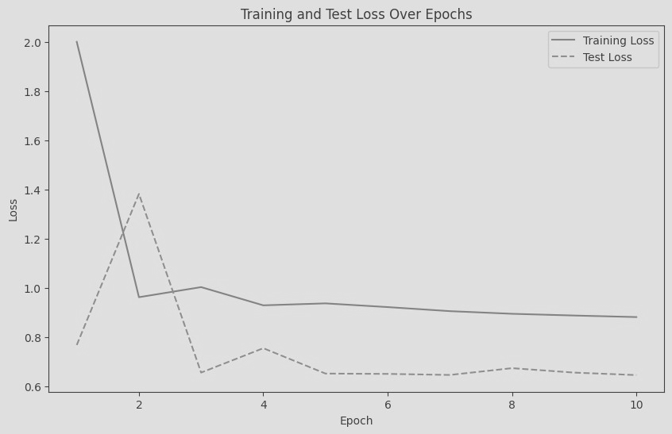
Experiments - Training
LSTM
LSTM & BERT

Slide 8
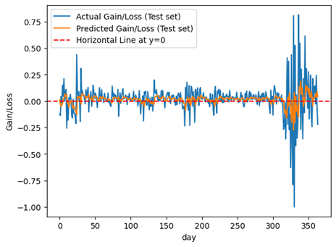
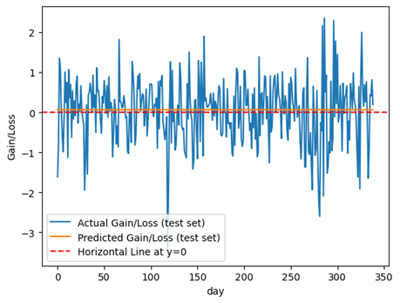
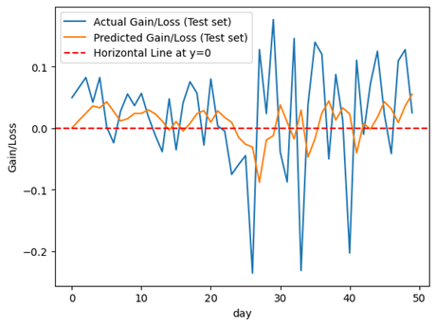
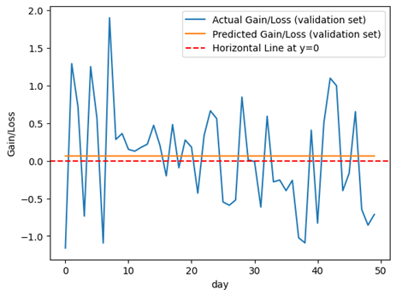
Experiments - Test
LSTM
LSTM & BERT

Slide 9
Experiments - Results
LSTM
LSTM & BERT
Actual vs. Predicted: 0.02833
Actual vs. 0: 0.02376
Actual vs. Avg gain: 0.02375
Results are worse than the naive predictor, look like random noise.
Actual vs. Predicted: 0.66191
Actual vs. 0: 0.66051
Actual vs. Avg gain: 0.66050
The model reverts to a predictor that is close to the naive one, and gets extremely similar results.

Slide 10
Conclusion
Models failed to outperform the naive approach of constant gain, as somewhat expected due to the unpredictable nature of the problem.
Future Directions:
Predicting long term trends instead of daily gain/loss
Incorporate diverse datasets (e.g., interest rates, national debt)
Improve architecture with more computational resources
Address dataset differences for model comparison
Thank you!

